Slide 1
Chapter 4 Branching Statements
By
Hyung Jae (Chris) Chang
Troy University

Slide 2

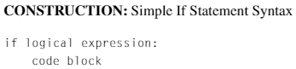
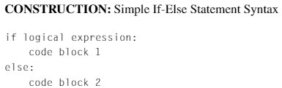
If-Else Statements
Used to run blocks of code only if certain conditions are met.
The conditions are represented as logical expressions.
The same level of indentation for every line of code within a conditional statement

Slide 3
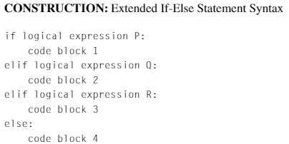
Extended If-Else Statement

Slide 4
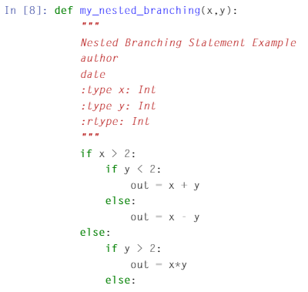

Nested If Statements
An if statement that is entirely contained within a clause of another if statement.

Slide 5
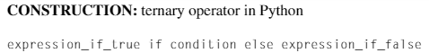
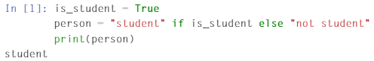
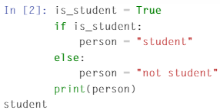
Ternary Operators
Conditional expression that provides a mechanism using a one-line code to evaluate the first expression if the condition is true; otherwise, it evaluates the second expression.

